Slide 1

Stadium Ticket Booking System

Slide 2
GROUP MEMBERS
GROUP MEMBERS
Sravika Cheguri – 700740507
Lnu Rumana Thaskeen –700742859
Yamini Yalabaka – 700740251
Pranavya Chowdary - 700739974

Slide 3
Introduction
Live tournament games have gained immense popularity in our society. People have a great interest in witnessing these matches unfold in real-time. Consequently, there is a high demand for live game tickets.
However, arranging the seating for these matches poses a challenge for the organizers as they may distribute the seats to their family and friends. This unfair distribution creates a negative impact on the audience's perception of the game.

Slide 4
Objective Of the Project
To overcome these we can develop one website, Stadium Seat Booking. Through this website people can book the stadium ticket at any place at any time.
In our project we have three modules: Admin, GameHost, Audience. Game Hosts can add the sports schedule details like game title , number of teams, number of players in a team, game duration, start time date and end time date. The game host adds the upcoming game schedules and also adds the number of seats present in that stadium in different categories.
Booking type is two ways one is couple booking and general booking. One audience can book only 10 seats for one account. Audience will receive the complimentary food if provided by the organiser, which they can see while booking the seats.

Slide 5
continuation..
Through this website the audience can book the seat and pay the amount. From that amount 5% of the amount will be transferred to the admin account and 95% of the amount will be transferred to the game host.
Admin can login with predefined credentials. The admin can view the registered gamehost(organiser) and the admin only can approve the gamehost accounts then only the gamehost can login. The admin can add seats to the added stadiums. Admin can divide the seats into different zones like Orchestra, Mezzanine and Balcony.
In these zones again there are two types: couple type and general type.The admin does not add the price to the seat. The admin can view the added seats to the stadium. The admin can view the gamehost added game schedules.
The admin can view the total bookings of the scheduled games.

Slide 6
continuation..
Game host registers with their details
Game host cannot login directly
Admin approves game host account before login is allowed
Game host gains login access after admin approval
The game host can add the upcoming games schedules
Only game host can choose the admin added stadiums and select the wanted stadium with the available seats for the couple and general audience, a seat has attributes like seat label, price per seat like different seats have different prices this is added by game host only, complimentary food details, then the host will publish.
While the game host before adding the game schedule they check other sports schedules also because there should not be any other game schedule at the same time. To check this we will use the datetime functions. By doing this we can avoid the time conflict from one game to another game.
The audience can login with their email with OTP sent to their email and book the tickets.

Slide 7
Database Description
In the Stadium ticket booking system we have seven database collections.
Admin have default login credentials. Admin will login and add stadium name, stadium type which means indoor, outdoor or open air, stadium location and address. This data of the stadium will be stored in the Stadium collection.
Admin add time slots for the stadium. The time slot collection contains the timeslot_Id, date and time, status for defining the availability of the time slot. stadium_Id is the reference key from the stadium collection to represent the stadium.
Game organiser will register in order to log into the system. The registrations of each game organiser will be stored into the Game Organiser collection with game organiser’s name, email, phone, address, password, account_status, picture. Game organisers profiles will be verified by the admin. The account_status of the game organiser will be inactive or not verified by default until the admin approves the game organiser. Game organiser will login after his account is activated and add the game schedule.

Slide 8

Schedule collection contains games and their scheduled timings
Game Organiser adds game schedule based on stadium time slots
Schedule collection includes gameTitle, no_of_teams, no_of_players, game duration, timeslot_Id, and gameOrganiser_Id
Game Organiser can only select time slot if status in time slot collection is available
Tickets collection contains data about game tickets, including seat price based on game and Is_coupleseat feature
Tickets collection includes schedule_Id reference key for representing game schedule
Audience logs in with OTP to book tickets using email and phone
Audience collection stores name, email, phone, and Id of audience
Bookings Collection stores booking details, including audience_id, ticket_Id, seat numbers, booking status, and booking date
Booking status changes to booked when payment is completed

Slide 9

Database Model

Slide 10
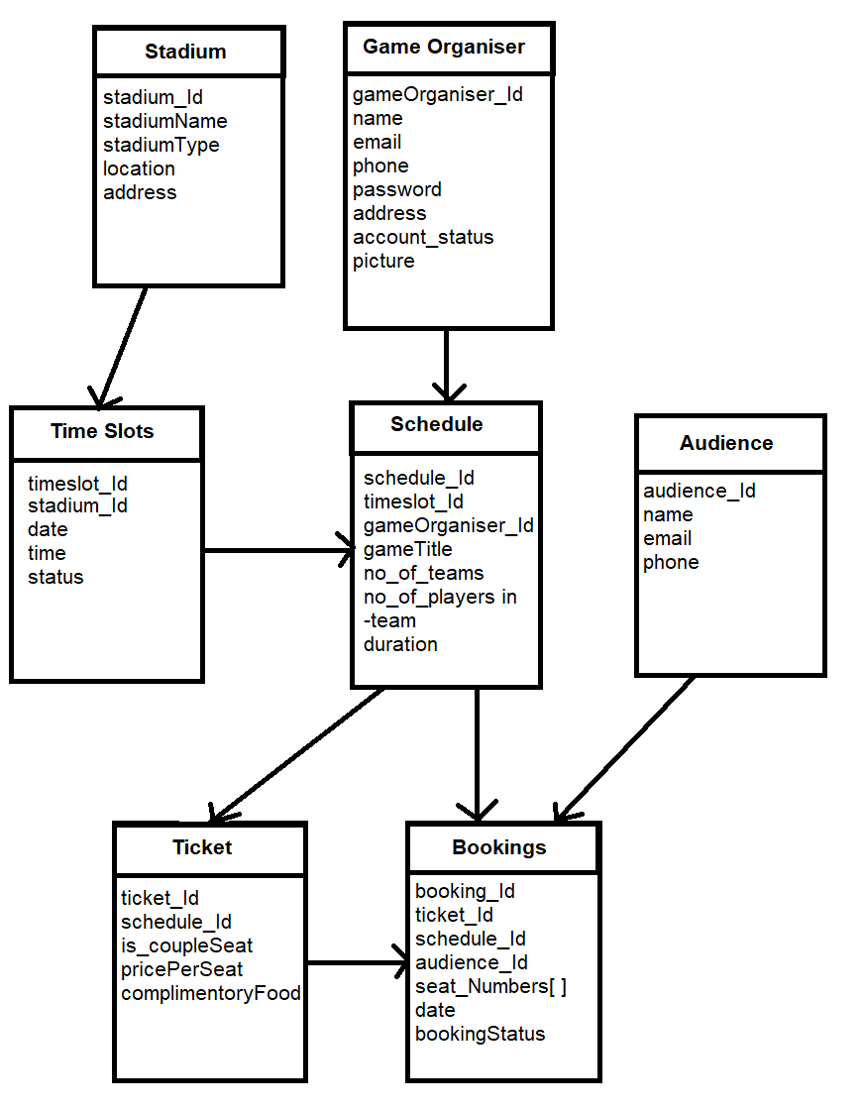

Slide 11
Admin
Admin will login with default login credentials.
View Game Organizers and do activate or deactivate the Game Host
Admin add stadium by giving its name and address details
Admin can view the added stadium and can update its details
Admin add time slots for the games play in the stadium

Slide 12
Game Organiser
Game Organiser will register and can login after verified by the admin
1
Game Organiser View time slots and book the time slot for a game
2
Game Organiser view the game schedule, Add tickets and define if there is couple seat or not
3
Game Organiser can view the ticket details and can view the booking made by the customers
4

Slide 13
Audience
Audience login with Email and OTP verification
Audience can view game schedule and book ticket
Audience can select couple seat or non couple seat
Audience can pay amount and confirm booking
Audience can view their booking and can also cancel or transfer the ticket

Slide 14
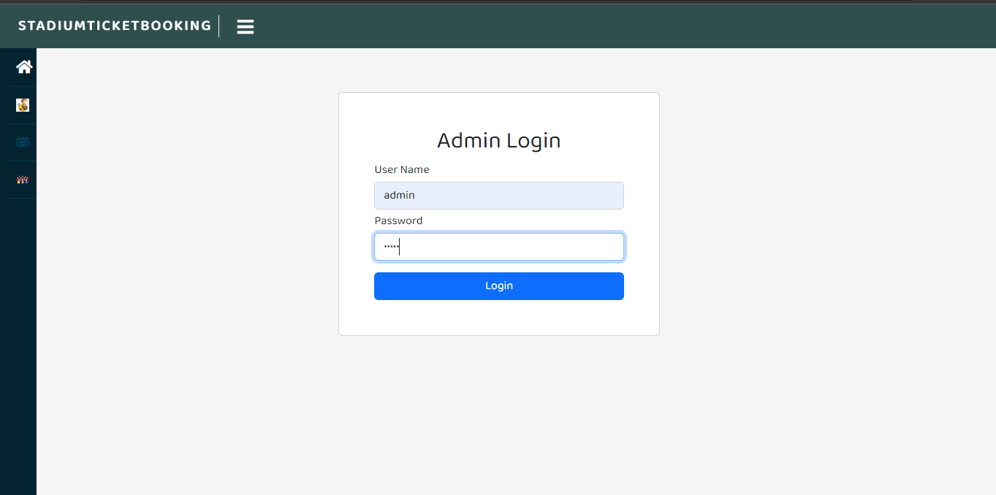
Admin Login

Slide 15
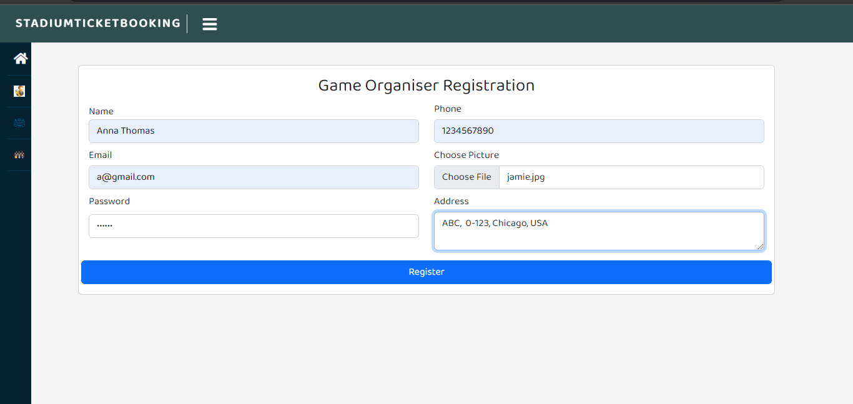
Game Organiser Registration

Slide 16
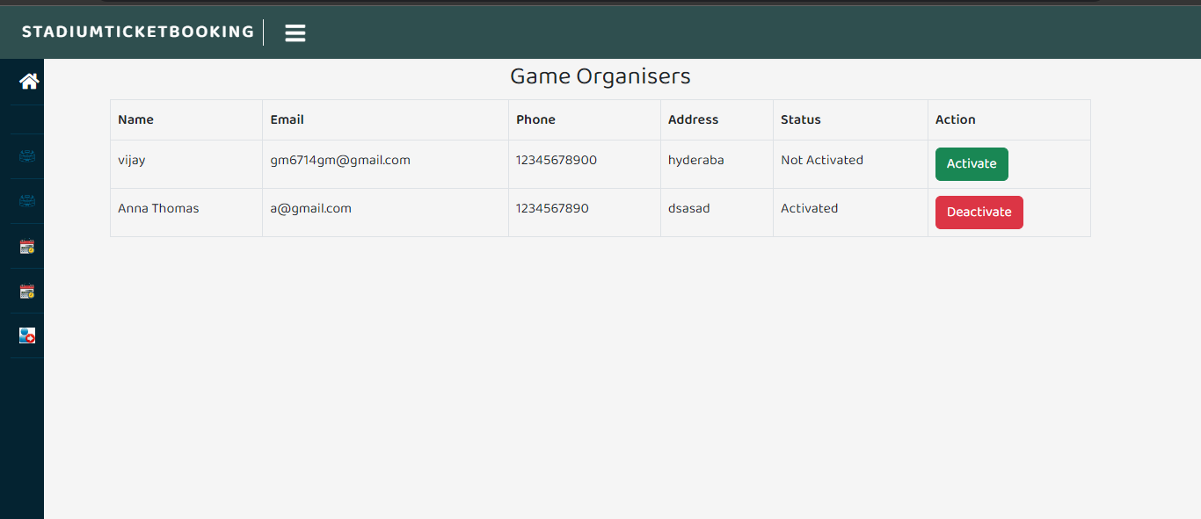
View Game Organiser

Slide 17
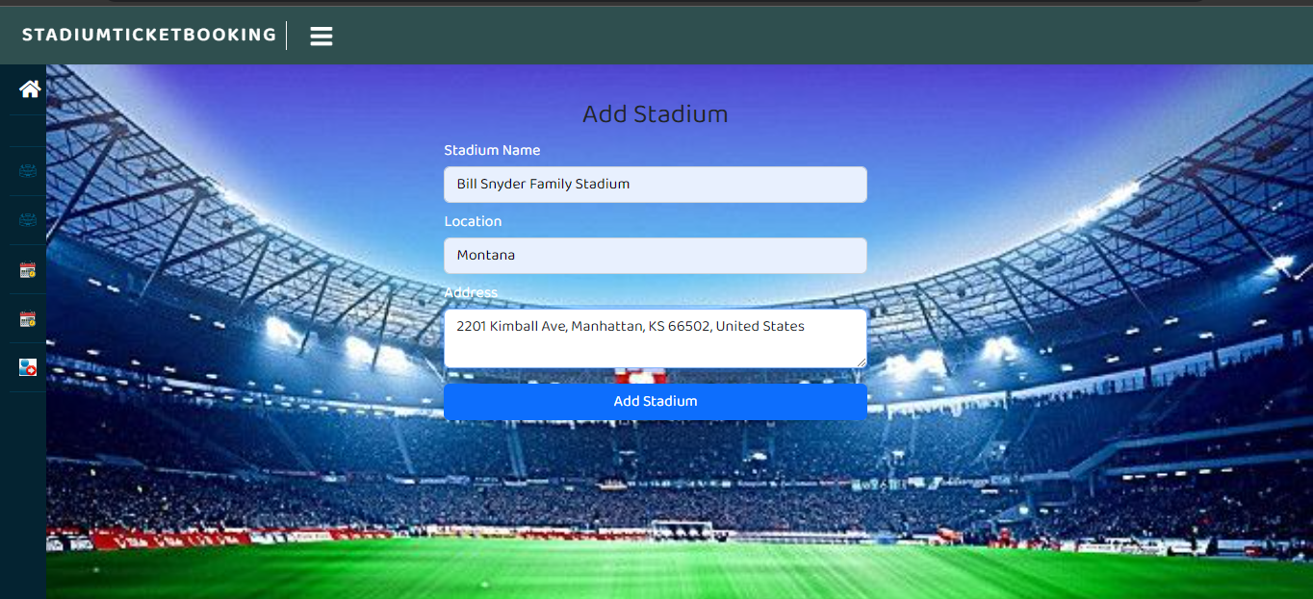
Add Stadium

Slide 18
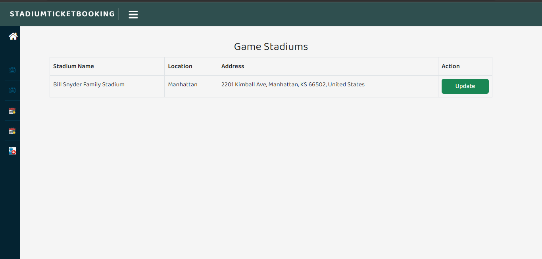
View Stadium

Slide 19
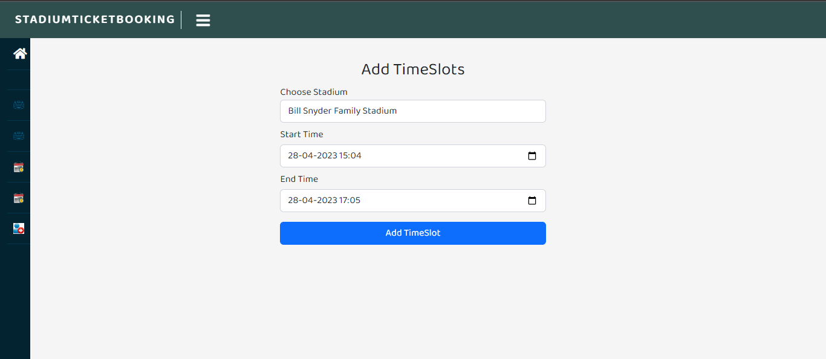
Add Time slot

Slide 20
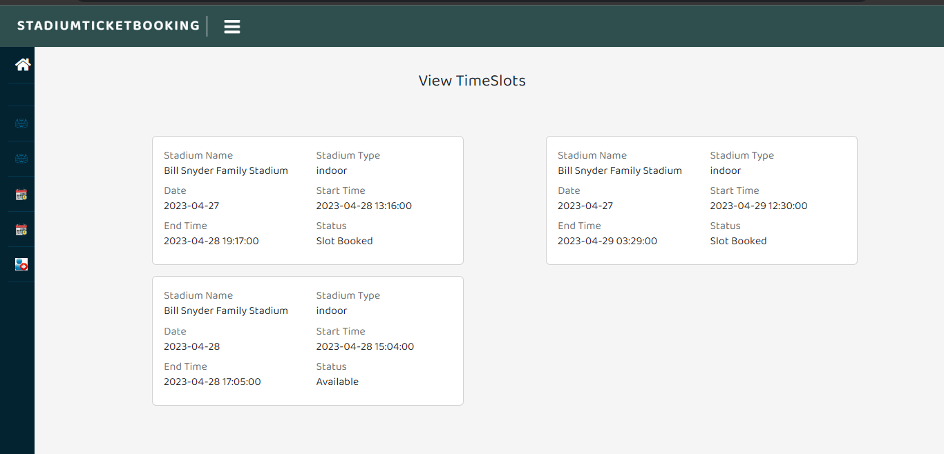
View Time Slot

Slide 21
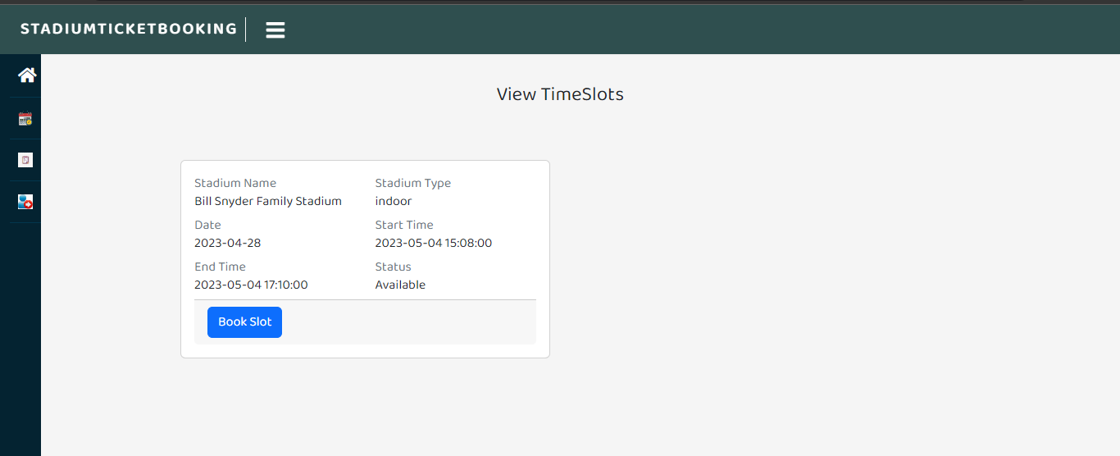
View Time slots in Game Organiser

Slide 22
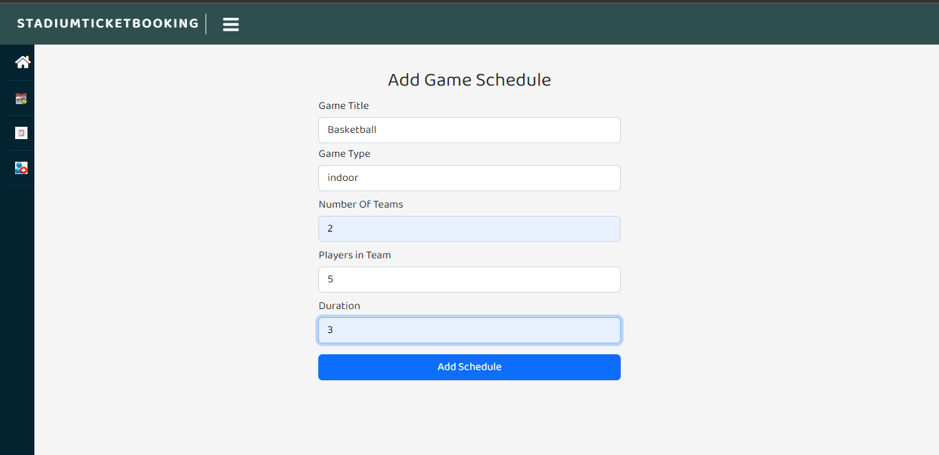
Add Game Schedule

Slide 23
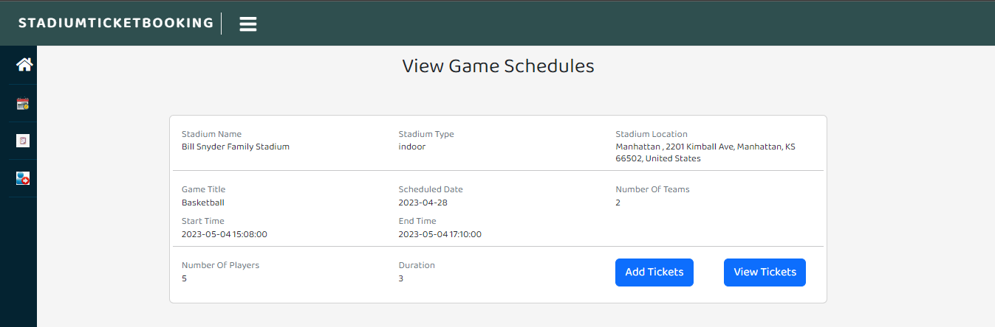
View Game Schedule

Slide 24
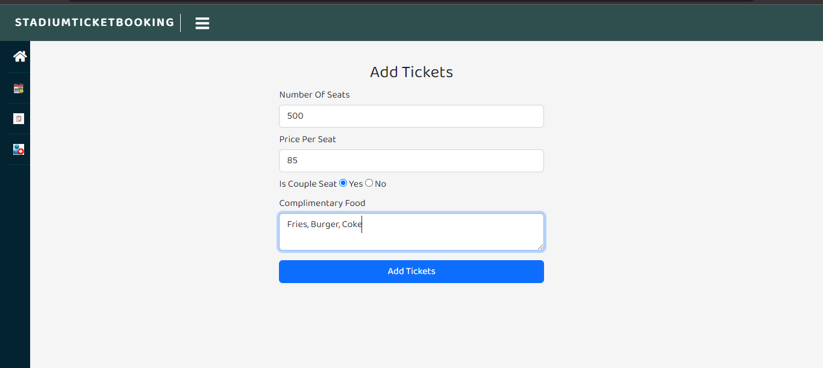
Add Ticket

Slide 25
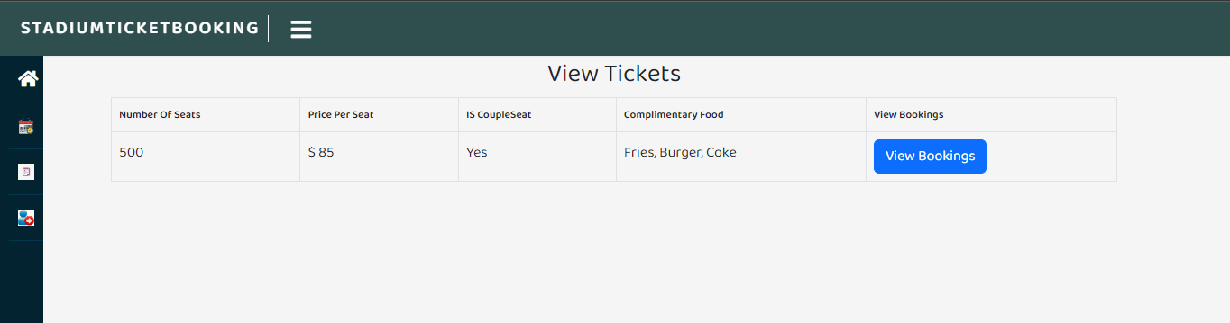
View Tickets

Slide 26
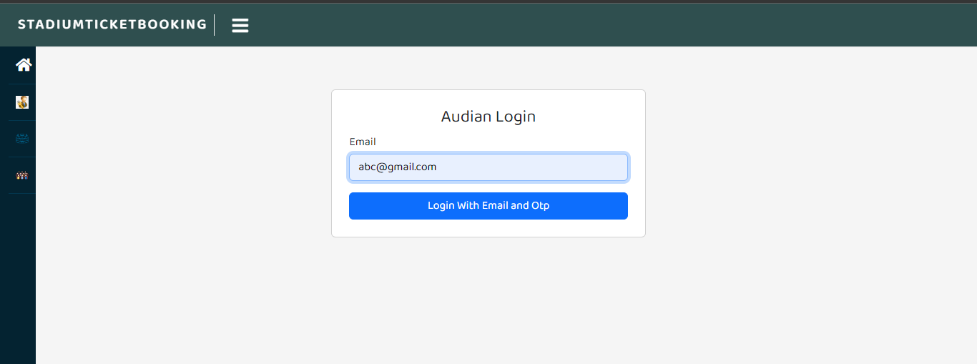
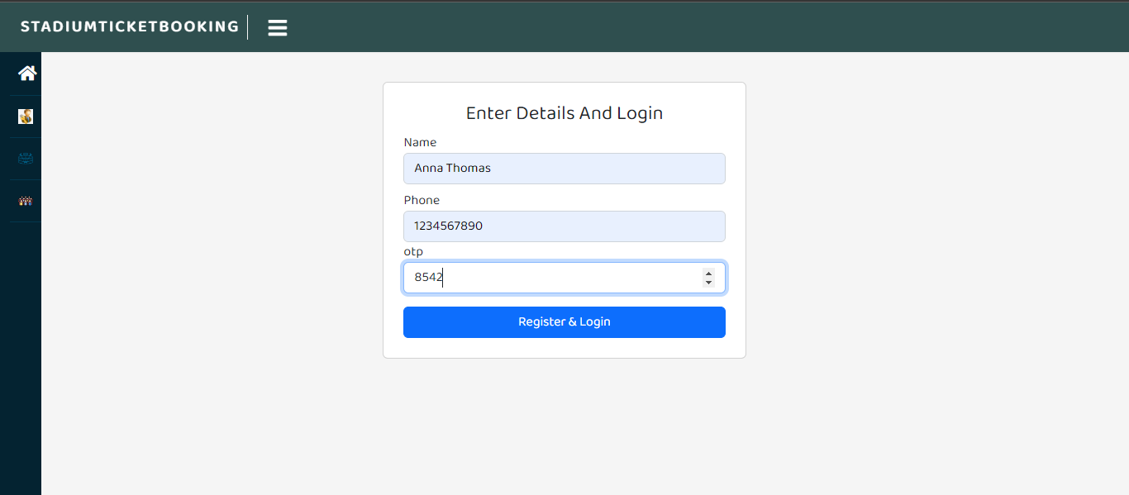
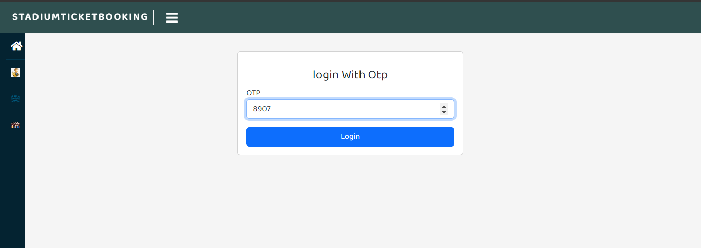
AUDIENCE Login

Slide 27
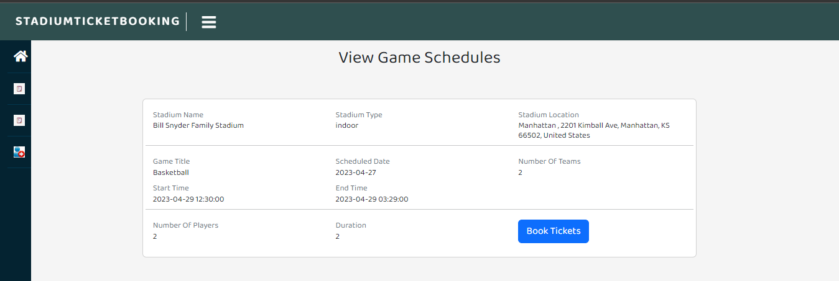
View Game Schedule

Slide 28
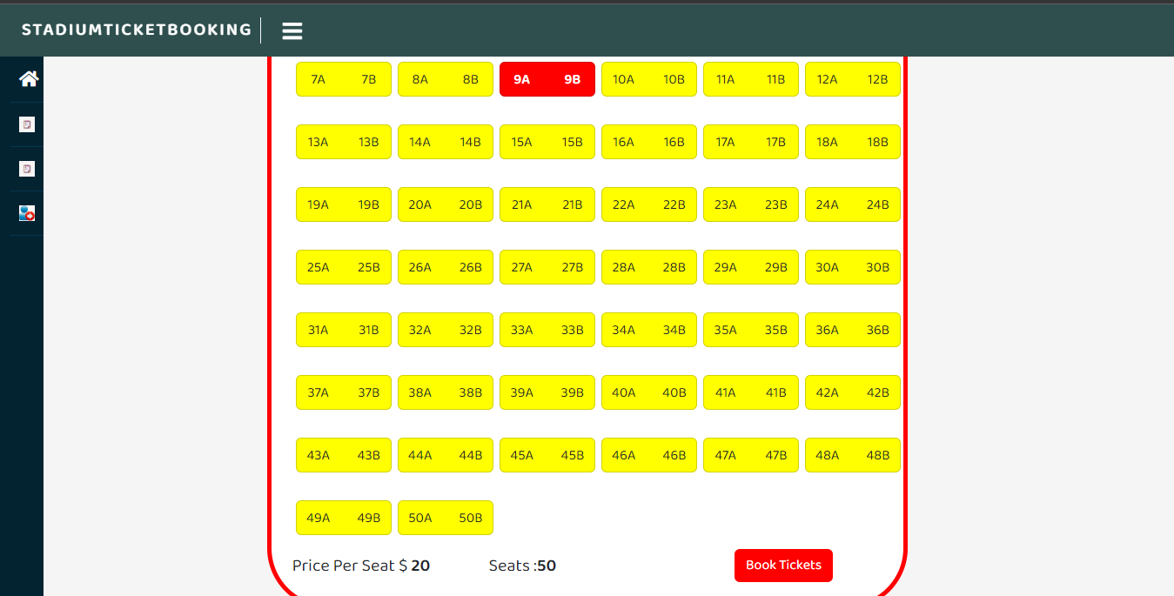
Select Seats

Slide 29
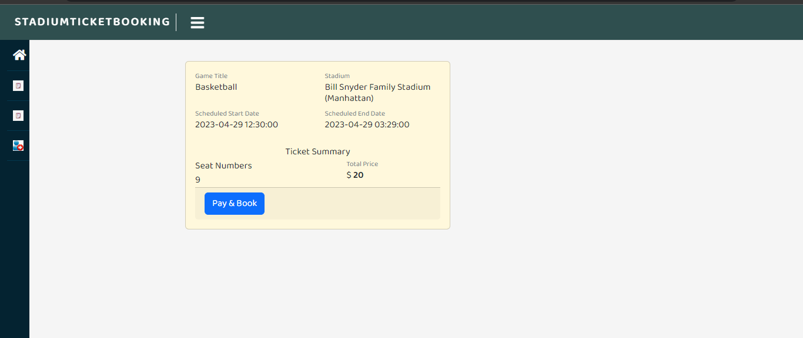
Ticket Summary

Slide 30
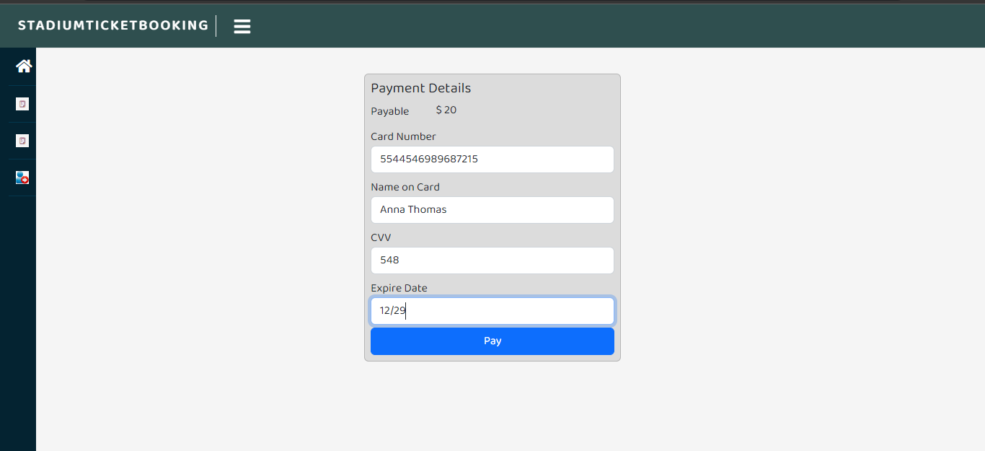
Payment

Slide 31
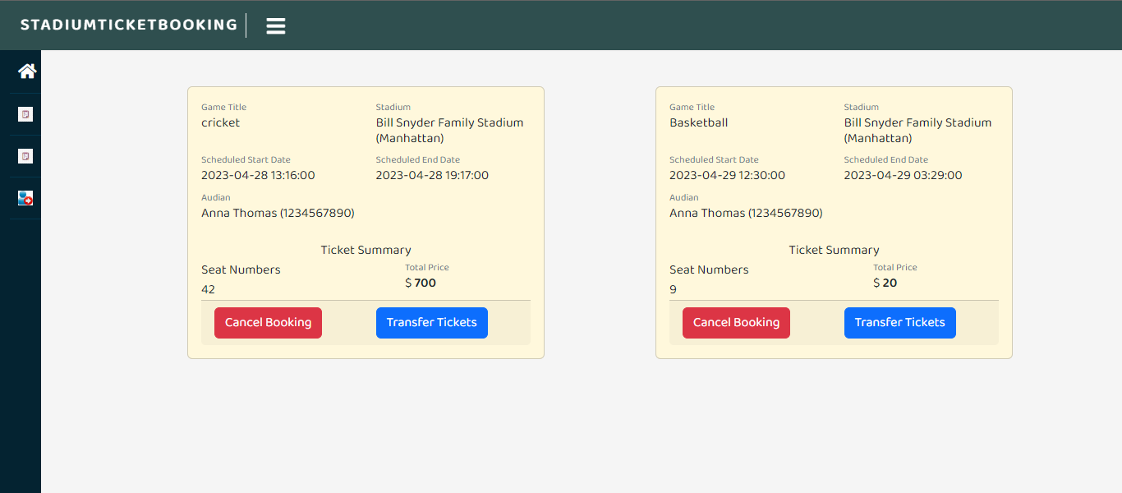
View Booking

Slide 32
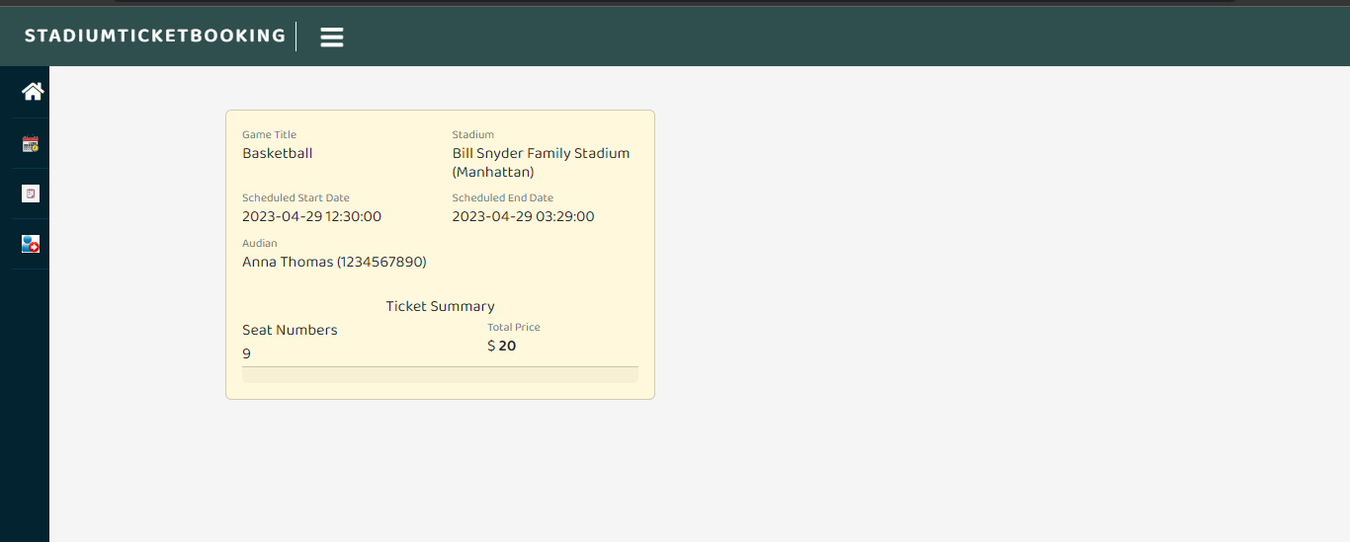
Game Organiser View Bookings

Slide 33
CONCLUSION
The stadium ticket booking system has streamlined the process of scheduling games, selling tickets, and managing bookings, resulting in improved efficiency and customer satisfaction.
The project has implemented appropriate data structures and databases for storing and managing data related to games, schedules, tickets, audience, and bookings.
The system shall improve the overall fan experience by providing a convenient and user-friendly platform for purchasing tickets and accessing information about games and schedules.

